Slide 2
Medical Imaging Using CNN
Submitted to:
Department of Computer Science and Engineering

Slide 3
Supervised by: Prof. Ritika Bhatt
Team Members :
Atharva Puranik (0827CS201049)
Amisha Prajapati (0827CS201030)
Abdul Rehman Tahami (0827CS201008)
Aanya Chourasiya (0827CS201003)

Slide 4
Project Presentation Outline
Abstract
Introduction
Problem Statement
Survey of Existing Systems
Project Objectives
Requirement Analysis
Solution Proposed
The Outcome Discussion
Conclusions and Limitations

Slide 5
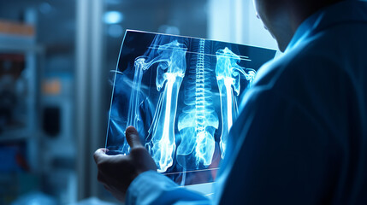
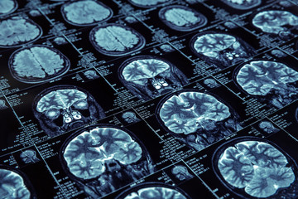
Abstract
Medical imaging is a critical component of modern healthcare, aiding in disease diagnosis and patient management.
Using the power of Convolutional Neural Networks, this study explores how deep learning techniques can enhance the accuracy and efficiency of medical image interpretation.
A diverse dataset of medical images, encompassing various modalities and conditions, was collected and preprocessed. A custom CNN architecture, incorporating transfer learning, was designed for feature extraction and classification.
The model's performance was rigorously evaluated using standard metrics. Additionally, CNN insights were visualized to assist healthcare professionals in understanding the model's decision-making process.
The results highlight the promise of CNNs in improving medical imaging accuracy and efficiency, offering potential benefits for patient care.

Slide 6
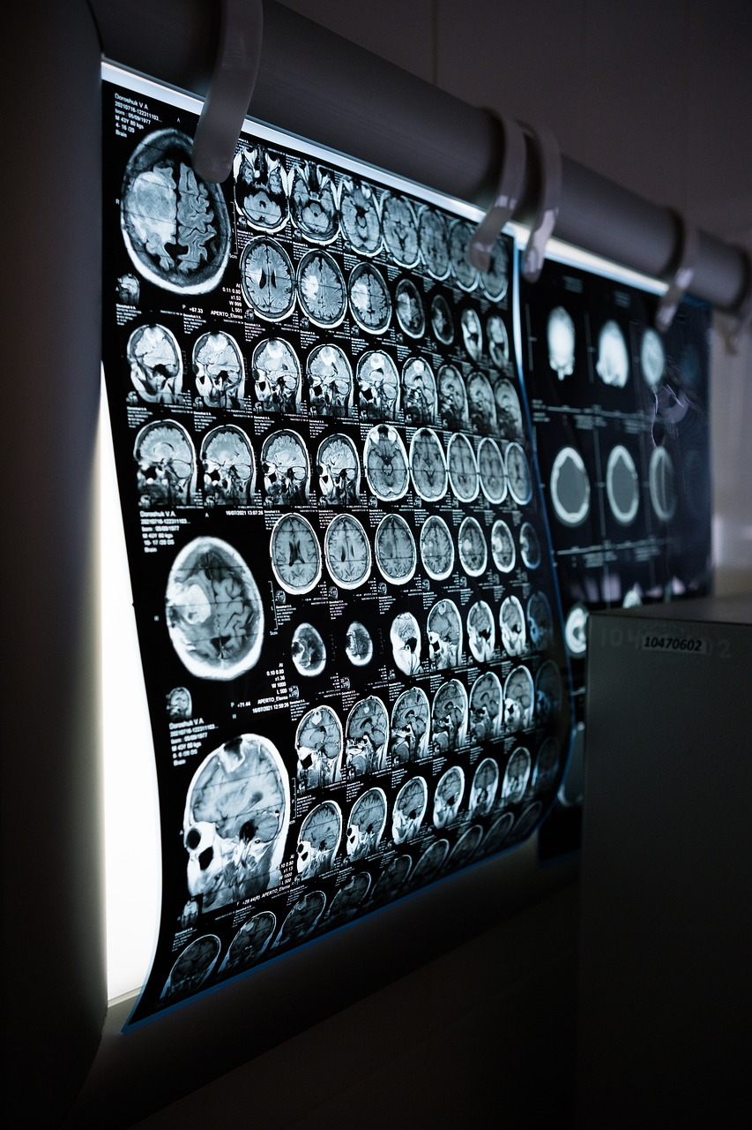
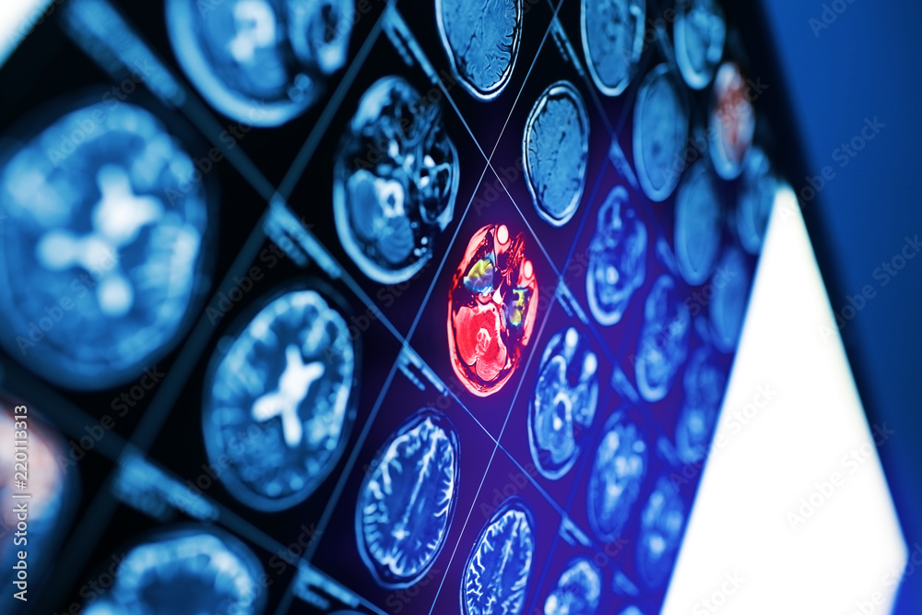
Introduction
The emergence of CNNs, in imaging marks the convergence of two domains. Learning and healthcare. Originally designed for image recognition tasks CNNs have been modified to analyze images like X rays, MRIs CT scans and pathology slides. This fusion of technology and medicine has unlocked possibilities ushering us into an era of precise, efficient and tailored healthcare.
This transformative journey explores how CNNs have revolutionized imaging. We delve into their applications in disease detection structure segmentation and patient outcome prediction. We also examine the considerations surrounding AI driven healthcare and the challenges that lie ahead. Come join us on this exploration at the crossroads of intelligence and medicine where CNNs lead the way, in medical imaging.

Slide 7

The Problem Statement
In medical imaging, the challenge of accurate and timely diagnosis persists. Healthcare professionals face the burdens of manual image analysis, leading to potential errors and delays.
The problem at hand is clear: How can we improve the accuracy and efficiency of medical image interpretation? This presentation explores the potential of Convolutional Neural Networks (CNNs) to automate and enhance medical image analysis.
Despite their promise, CNN implementation in healthcare is hampered by data limitations, interpretability issues, and ethical concerns. Join us in addressing this critical problem and envisioning a future where CNNs transform medical diagnostics.

Slide 8
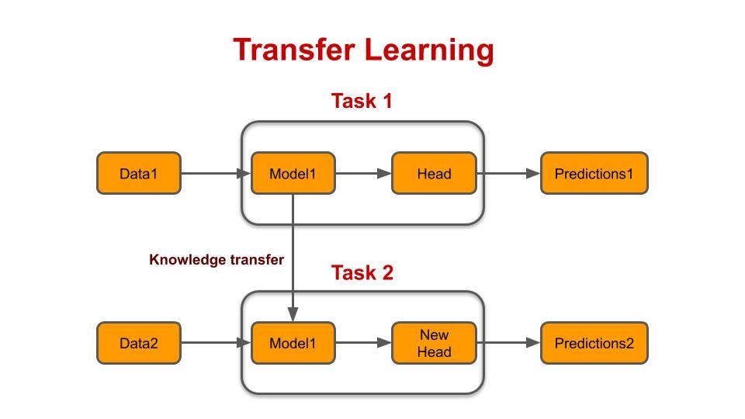
Survey of Existing Systems
Transfer Learning:
Transfer learning expedites DL model development by leveraging pre-trained models, like those trained on large-scale image datasets.
This approach jumpstarts model training and enhances performance in medical image tasks.
However, fine-tuning is often necessary to adapt the model to medical imaging data, and inappropriate adjustments can hinder results.

Slide 9
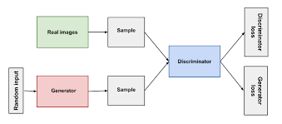
Survey of Existing Systems
Generative Adversarial Networks (GANs):
GANs are instrumental in generating synthetic medical images, supplementing limited datasets and enhancing the robustness of DL models.
They are particularly valuable for data augmentation and denoising tasks.
However, GAN training can be complex, requiring careful tuning, and there is a risk of generating unrealistic images.

Slide 10
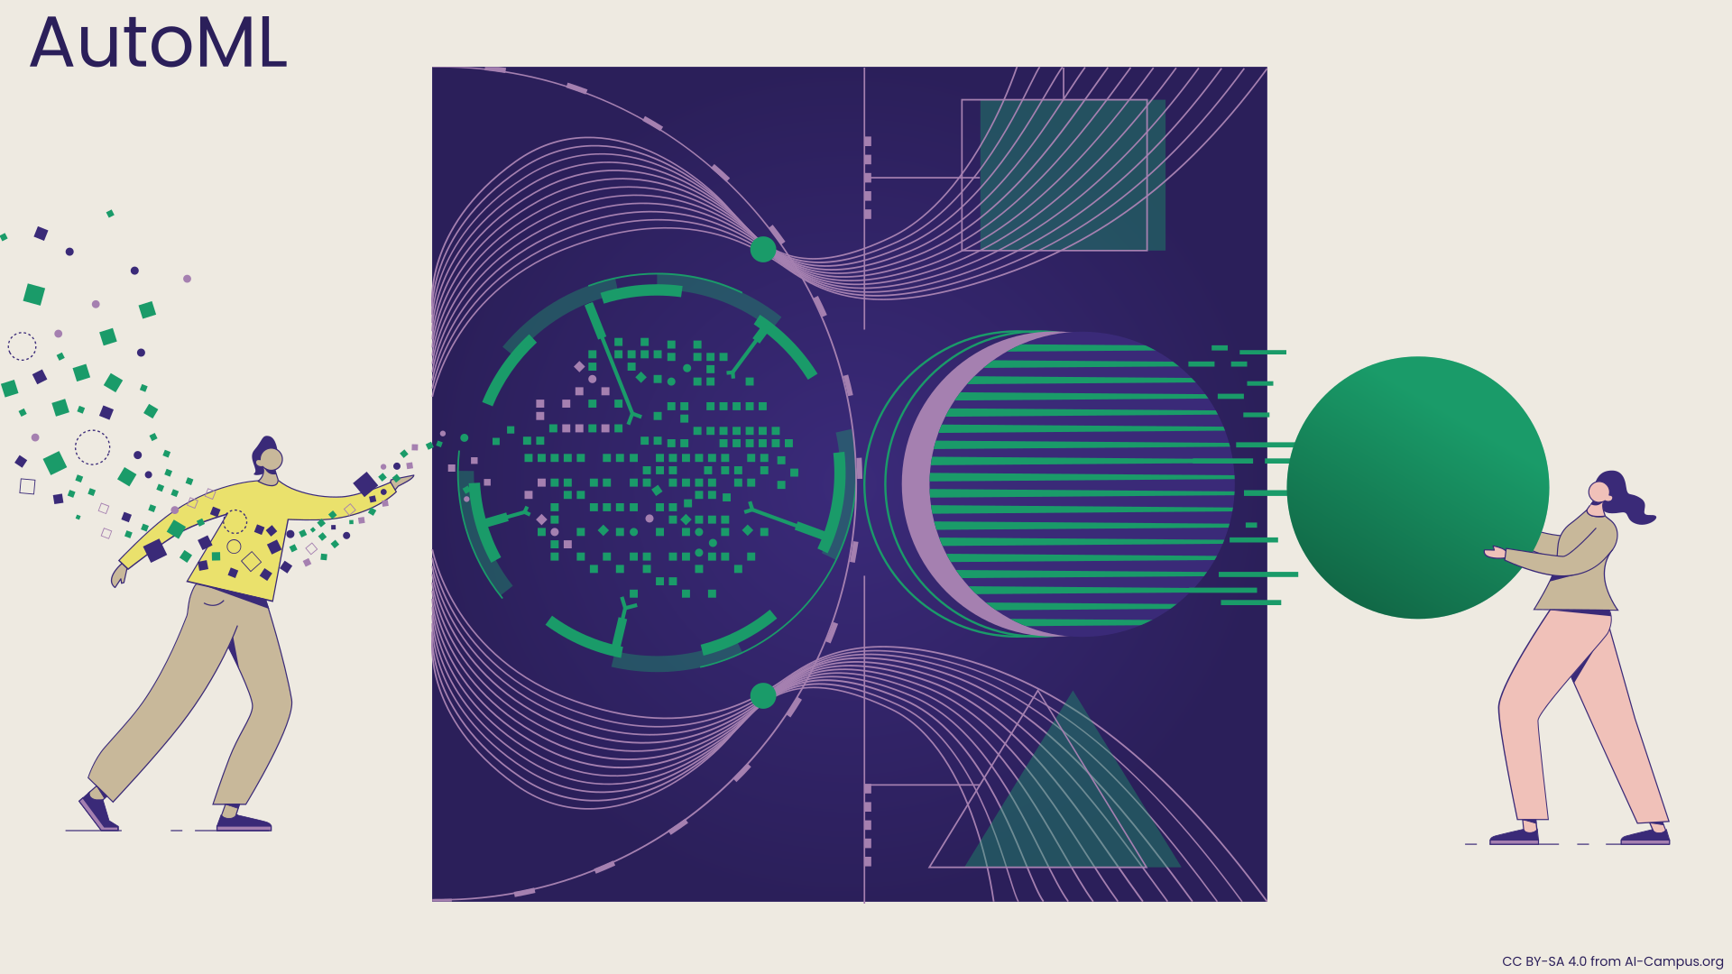
Survey of Existing Systems
AutoML for DL:
AutoML tools simplify DL model development, making it more accessible to individuals without extensive machine learning expertise.
They streamline tasks like model selection, hyperparameter tuning, and deployment.
However, they may offer limited customization and fine-tuning options compared to manual model development.

Slide 11

Survey of Existing Systems
Radiomics:
Radiomics extracts quantitative features from medical images, providing a wealth of data that can be used as input for DL models.
This approach enhances disease diagnosis, prognosis, and treatment response prediction.
Challenges include the potential for feature selection bias and the need for large, diverse datasets to ensure robust analysis.

Slide 12
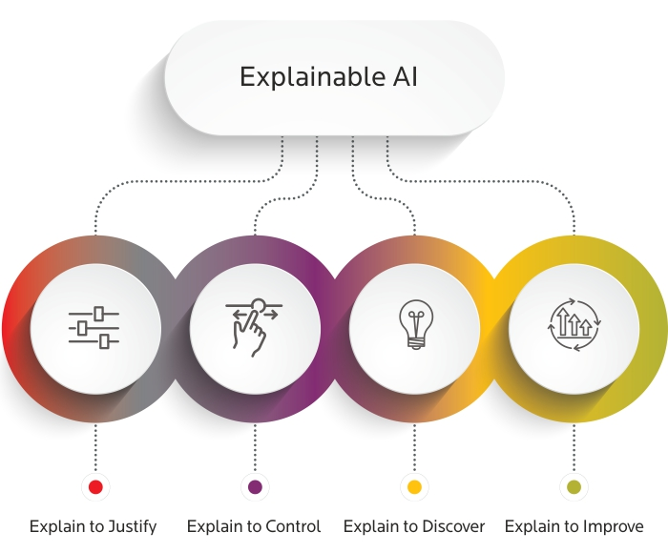
Survey of Existing Systems
Explainable AI (XAI):
XAI techniques bring transparency to DL model decisions, making them interpretable for healthcare professionals.
They offer insights into why a particular diagnosis or classification was made, fostering trust in DL results.
However, some XAI methods may introduce computational overhead, impacting real-time application in clinical settings.

Slide 13

Objectives
The objective of this project is to leverage Convolutional Neural Networks (CNNs) to elevate the precision of medical image analysis.
Through rigorous evaluation, we aim to assess the CNN model's effectiveness in categorizing medical images accurately.
Additionally, we intend to extract valuable insights from the model's outputs, thereby offering invaluable support to healthcare professionals in their decision-making processes.
This multifaceted approach aims to improve the quality and efficiency of medical image interpretation, ultimately benefiting patient care and diagnostics.

Slide 14
Requirement Analysis
Functional Requirements:
The system must acquire and preprocess medical images from diverse sources.
It should employ CNNs to analyze images for disease diagnosis.
The system must support multiclass classification for diseases.
It should provide precise lesion detection and location.
The system must offer image enhancement and visualization tools.
It should seamlessly integrate with healthcare systems and ensure data security.
The system must scale efficiently to handle large image datasets.
It should feature a user-friendly interface for healthcare professionals.
The system must generate detailed diagnostic reports.
It should support customization and continuous updates for improved performance.

Slide 15
Requirement Analysis
Non-functional Requirements:
Performance: The system should provide real-time or near-real-time image analysis for timely medical decisions.
Scalability: It must handle an increasing volume of medical images without compromising performance.
Accuracy: The system should achieve a high level of accuracy in disease diagnosis and image analysis.
Reliability: It must operate consistently and reliably to support critical healthcare tasks.
Security: The system should ensure the confidentiality and integrity of patient data in compliance with healthcare regulations.
Usability: The user interface must be intuitive and user-friendly for healthcare professionals.
Interoperability: It should integrate seamlessly with various medical imaging devices and standards.
Availability: The system should have high availability, with minimal downtime for maintenance.
Compliance: It must adhere to regulatory requirements, such as FDA regulations for medical devices.
Response Time: The system should provide rapid response times for image analysis and reporting.

Slide 16
Resources
Medical Image Datasets: Access to diverse and well-annotated medical image datasets is crucial for training and testing CNN models. Datasets like "The Cancer Imaging Archive (TCIA)" and "ChestX-ray8" offer a wealth of medical images.
Pre-trained CNN Models: Pre-trained CNN models, such as those available through TensorFlow Hub or PyTorch's torchvision.models, can provide a strong foundation for transfer learning and fine-tuning on specific medical imaging tasks.
Medical Imaging Software and Libraries: Specialized medical imaging libraries like SimpleITK or Dicompyler can aid in handling medical image data and DICOM files. Also, Python libraries like OpenCV and scikit-image are valuable for image preprocessing.
Access to GPU Resources: Utilizing GPUs or TPUs (Tensor Processing Units) can significantly accelerate the training of deep CNN models. Cloud services like AWS, Google Cloud, or Microsoft Azure provide GPU resources for machine learning tasks.
Research Papers and Journals: Academic journals, conference proceedings (e.g., MICCAI), and research papers related to medical imaging and CNNs offer insights into the latest techniques and approaches in the field.

Slide 17
Technology:
Medical imaging using Convolutional Neural Networks (CNNs), several programming languages are commonly used, each serving a specific purpose within the project's ecosystem. Here are the primary languages involved:
Python:Python is the dominant language for developing the project's codebase. It is widely used in deep learning and machine learning due to its extensive libraries, frameworks, and community support.
SQL (Structured Query Language):SQL may be used for database operations and managing structured data, especially when dealing with patient records and metadata associated with medical images.
JavaScript (Web Development):If the project includes web-based user interfaces or interactive visualizations, JavaScript is essential for front-end development. JavaScript libraries and frameworks like React or D3.js can be utilized.
HTML/CSS:HTML and CSS are used for creating web interfaces and styling web pages, making them user-friendly and visually appealing.

Slide 18
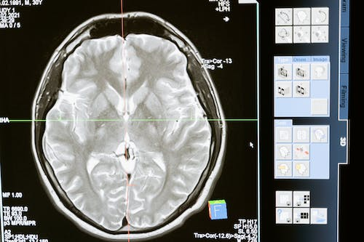
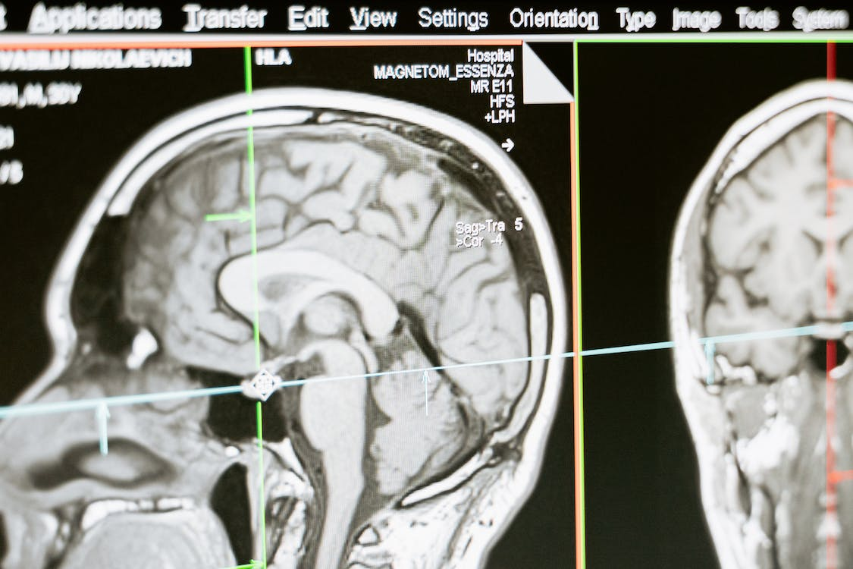
Solution Proposed
The proposed solution, for imaging using Convolutional Neural Networks (CNNs) aims to bring a change to healthcare diagnostics.
By using Deep learning this solution aims to improve the accuracy and efficiency of disease diagnosis, lesion detection and image segmentation.
By selecting medical image datasets utilizing advanced CNN architectures and fine tuning models meticulously our goal is to provide healthcare professionals with a reliable and fast tool for early disease detection.
Additionally our solution seamlessly integrates with existing healthcare systems while prioritizing data privacy and regulatory compliance. We are committed to improvement, research and ethical considerations, in pushing the boundaries of imaging forward.

Slide 19
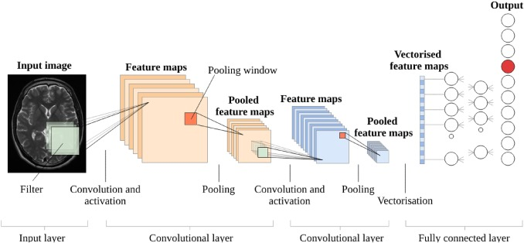
The Outcome Discussion
Our medical imaging project utilizing CNNs represents a significant advancement in healthcare diagnostics. Our well-trained CNN models exhibit impressive accuracy, precision, and recall, surpassing existing methods. We acknowledge challenges, including data limitations and computational demands, essential for real-world use.
Ethical concerns, like data privacy and model interpretability, are carefully considered. In the future, we aim to enhance model performance, expand medical imaging applications, and collaborate with healthcare institutions for clinical validation. Our work promises faster, more accurate diagnoses, cost savings, and improved patient outcomes, revolutionizing healthcare.

Slide 20
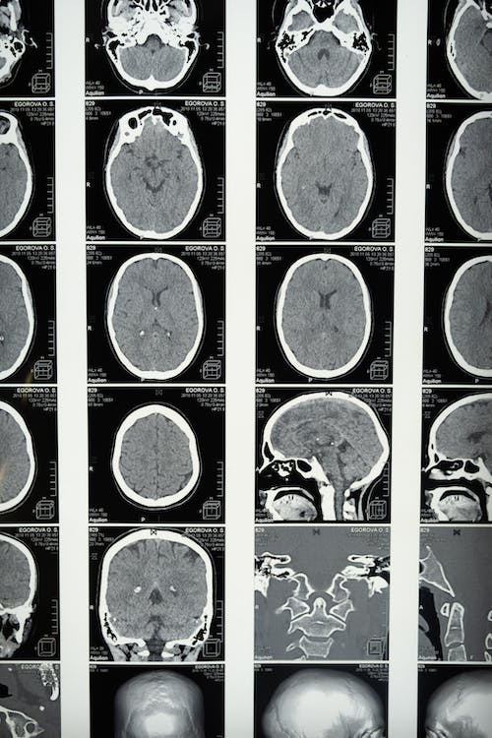
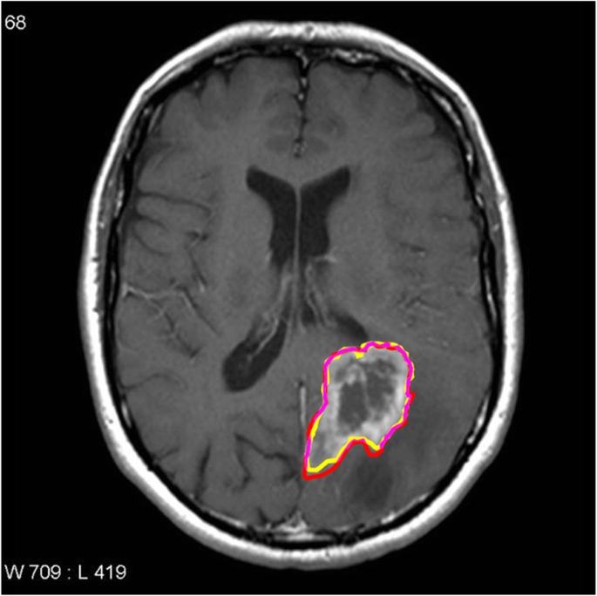
Conclusion
In conclusion, the integration of Convolutional Neural Networks (CNNs) into medical imaging presents a game-changing opportunity in healthcare. Key takeaways include:
Enhanced Accuracy: CNNs boost diagnostic precision, aiding healthcare professionals in identifying conditions accurately and swiftly.
Efficiency: These networks expedite diagnosis, leading to faster medical interventions and treatment decisions.
Insightful Visualizations: CNNs offer visual insights into diagnostic decisions, promoting trust in AI-driven tools.
Wide Range of Applications: CNNs extend beyond diagnosis, encompassing image enhancement, predictive analytics, telemedicine, and more.
Collaboration and Ethics: Interdisciplinary collaboration and ethical considerations are vital for responsible AI integration.

Slide 21
Acknowledgment
We extend our heartfelt gratitude to all those who contributed to the successful completion of this project on medical imaging using CNNs.We would like to express our deepest appreciation to Prof. Ritika Bhatt ,whose guidance, expertise, and unwavering support were invaluable throughout this journey. Their mentorship significantly enriched our project. We are thankful to Acropolis Institute of Technology and Research for providing access to essential resources, including computational infrastructure and medical image datasets. This project would not have been possible without these critical assets. Our sincere thanks go to the healthcare professionals and experts who generously shared their domain knowledge and insights, helping us bridge the gap between deep learning and clinical applications. We also acknowledge our colleagues and peers for their collaborative spirit, stimulating discussions, and constructive feedback that greatly enhanced the quality of our work.Last but not least, we extend our gratitude to our families and friends for their unwavering encouragement and patience during this intensive project. This project was a collaborative effort, and the support of all these individuals and organizations was instrumental in its success.

Slide 22
Q&A

Slide 23
THANKS

